Slide 1

Traffic Volume Prediction Project
Our traffic volume prediction project leverages advanced data analysis and visualization techniques. Using Pandas, NumPy, Seaborn, and Matplotlib, we processed and visualized traffic data to uncover meaningful patterns and insights.

Slide 2

Data Preprocessing Overview
1
Data Loading
Imported CSV file containing DateTime, Vehicles, and other relevant columns using Pandas.
2
Cleaning
Addressed missing values and inconsistencies in the dataset to ensure data quality.
3
Feature Engineering
Created new features from existing data to enhance predictive power of the model.

Slide 3
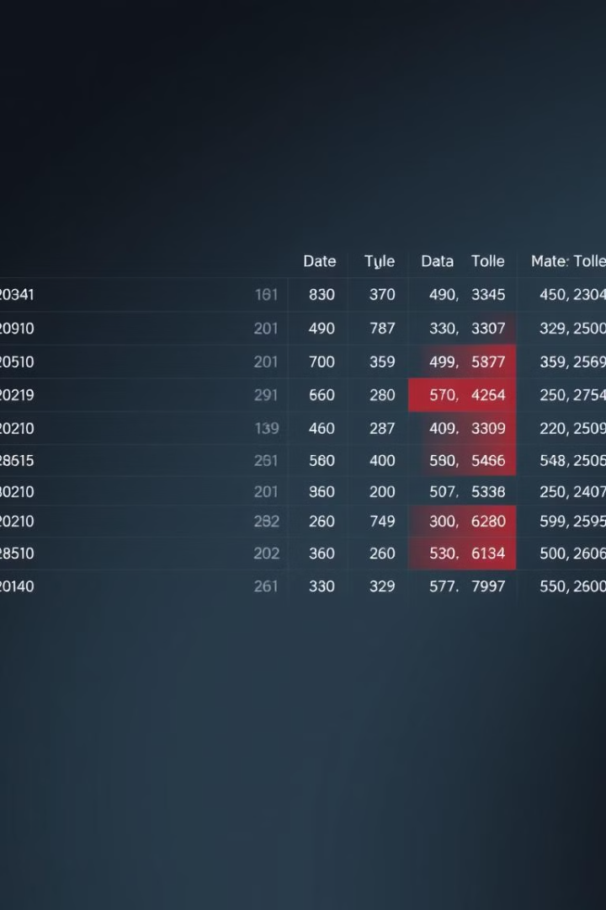
Handling Missing Values
Identification
Imputation
Used Pandas to detect null values across all columns in the dataset.
Applied appropriate techniques like mean, median, or advanced algorithms to fill gaps.
Verification
Ensured data integrity by double-checking the imputed values for consistency and accuracy.

Slide 4




DateTime Feature Extraction
DateTime Column
Started with raw DateTime column containing timestamp information for each traffic record.
Hour Extraction
Used Pandas datetime functions to extract the hour component from each timestamp.
Day of Week
Calculated the day of the week (0-6) for each timestamp entry.

Slide 5
Feature Scaling with StandardScaler
Raw Data
Scaling Process
Scaled Features
Initial features had different scales, potentially biasing the model. Hour values ranged from 0-23, while vehicle counts varied widely.
Applied StandardScaler from scikit-learn to normalize features. This transformed data to have zero mean and unit variance.
Resulted in all features having comparable scales, improving model performance and convergence speed.

Slide 6




Visualization Techniques
Line Plots
Used for time series data to show trends over time.
Heatmaps
Visualized correlations between features and temporal patterns in traffic volume.
Histograms
Displayed the distribution of traffic volume across different time periods.

Slide 7
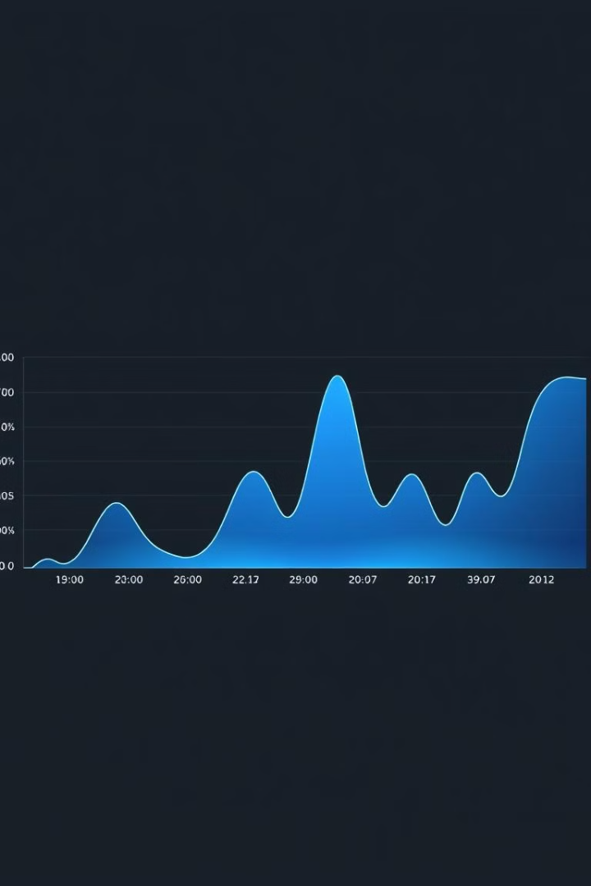
Traffic Volume Over Time
1
Time Series Plot
2
Trend Identification
Created a line plot using Matplotlib to visualize vehicle count changes over time.
Observed daily and weekly patterns in traffic volume, helping identify peak hours.
3
Anomaly Detection
Spotted unusual spikes or dips in traffic, potentially indicating events or data issues.

Slide 8
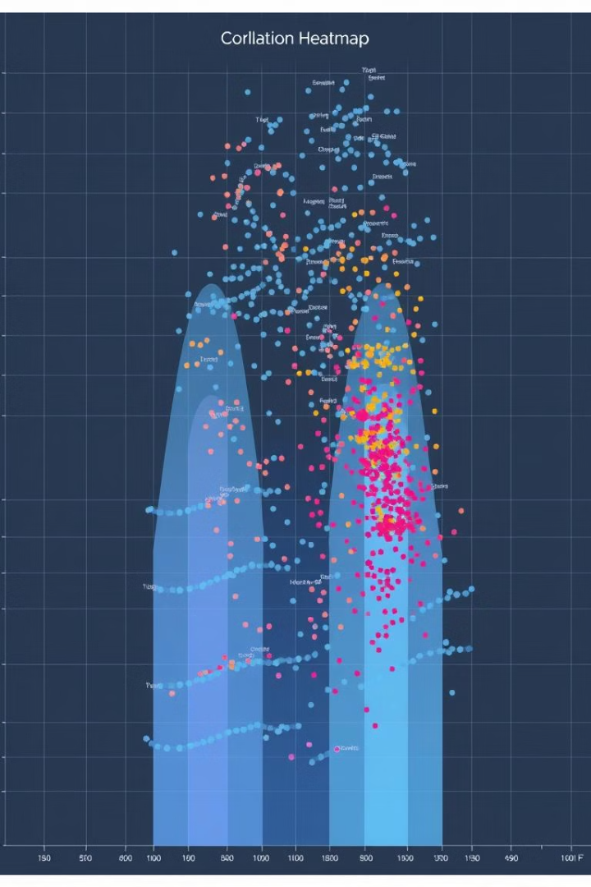
Correlation Heatmap
Feature
Vehicles
Hour
Day of Week
Vehicles
1.0
0.7
0.3
Hour
0.7
1.0
0.1
Day of Week
0.3
0.1
1.0

Slide 9
Distribution of Traffic Volume
Histogram
Density Plot
Insights
Created using Seaborn to show the frequency distribution of vehicle counts.
Overlaid a KDE plot to smooth the distribution and highlight overall trends.
Revealed the most common traffic volumes and identified potential outliers or unusual patterns.

Slide 10


Temporal Patterns Heatmap
Hourly Patterns
Daily Patterns
Visualized traffic volume variations across different hours of the day.
Illustrated how traffic patterns change throughout the week, revealing weekday-weekend differences.

